Slide 1
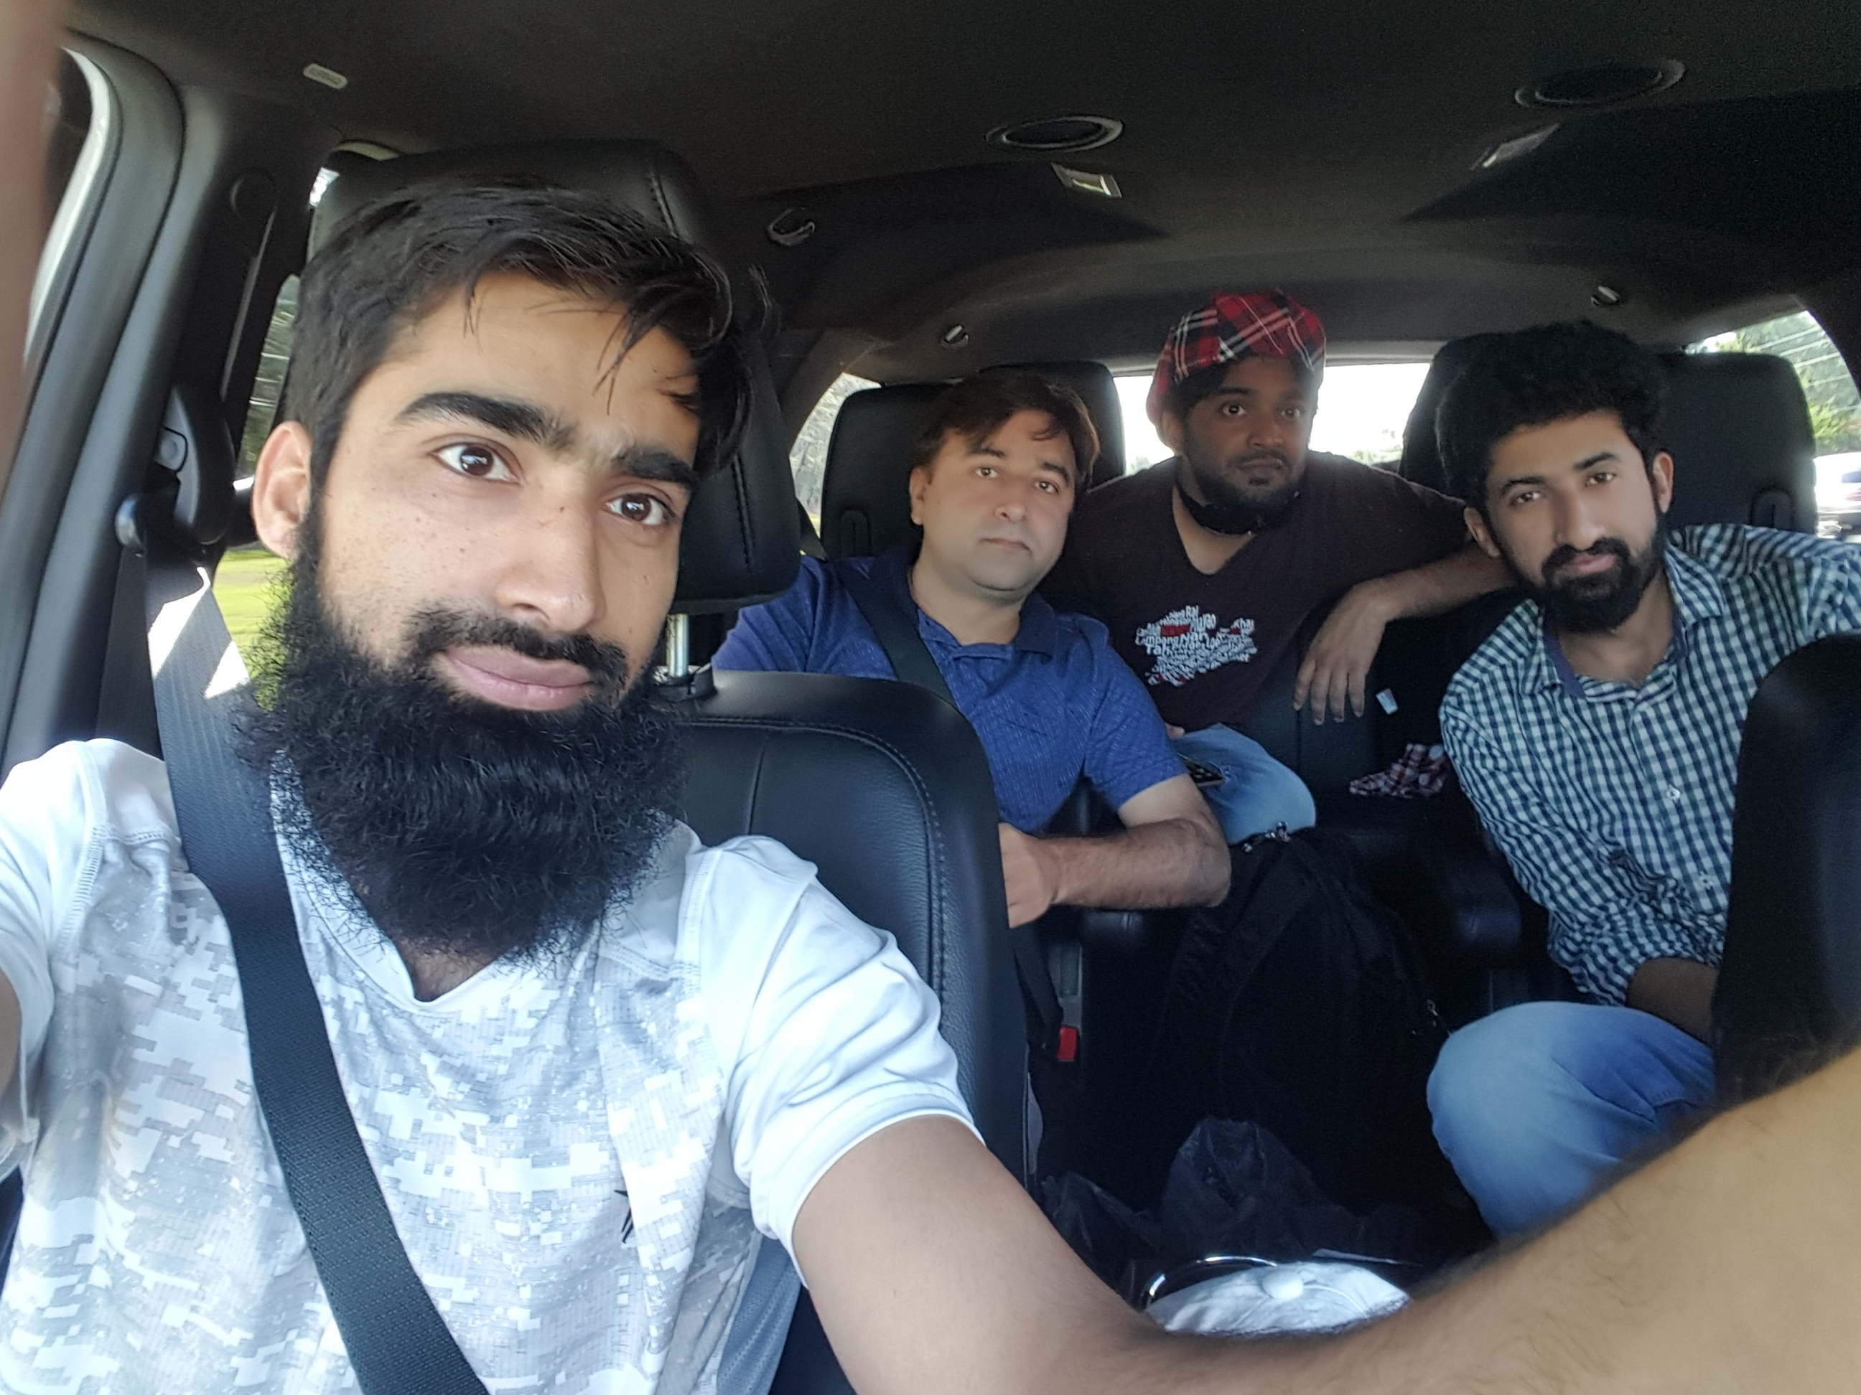
Dr. Sajid Iqbal
Department of Computer Science
Bahauddin Zakariya University, Multan

Slide 2
Computer Programming
Data structures

Slide 3
Background
The data we store in computer must be organized that it could be easily and efficiently read, write and processed
Definition: “A data structure is a data organization, management, and storage format that enables efficient access and modification”
A data structure is a collection of data values, the relationships among them, and the functions or operations that can be applied to the data
Each type of program may require different type of data structure
The data structures are usually built using primitive data types i.e. integers and floats
Each computer language may have different type of data structures
To do better programming, we need to know about the data structures

Slide 4
Python Data Structures
Built-in data structures
List
Dictionary
Tuple
Set

Slide 5
List
A list is collection of ordered and changeable elements
Items in list could be of any type
You can access individual elements of list using index
Element at particular index can also be changed
An element of different data type can be placed in place of any data item
Code | Output
theList=["multan", "lahore","Dera Ghazi Khan",560] print(theList) print(theList[0]) theList[0]="Islamabad" print(theList) theList[3]="Muzaffargarh" print(theList)
['multan', 'lahore', 'Dera Ghazi Khan', 560]
multan
['Islamabad', 'lahore', 'Dera Ghazi Khan', 560]
['Islamabad', 'lahore', 'Dera Ghazi Khan', 'Muzaffargarh’]

Slide 6
List Indexing
Indexing is the process to access a particular element in the list
Indexing is also used to access a subset of List elements
We can either do positive or negative indexing
Positive Indexing
0 | 1 | 2 | 3 | 4 | 5
Left Side
10 | 5 | 3 | 7 | 9 | 2
# list positive indexing SubjectList=["biology","botany","zoology","computer","mathematics", "Statistics"] print(SubjectList) print(SubjectList[0]) # print first element print(SubjectList[3]) # print fourth element print(SubjectList[2:5]) # print 3rd, 4th and 5th
element
['biology', 'botany', 'zoology', 'computer', 'mathematics', 'Statistics']
biology
computer
['zoology', 'computer', 'mathematics']

Slide 7
List Negative Indexing
Negative indexing starts from right side of the list
0 | 1 | 2 | 3 | 4 | 5
Left Side
Right Side
-6 | -5 | -4 | -3 | -2 | -1
# list negative indexing SubjectList=["biology","botany","zoology","computer","mathematics", "Statistics"] print(SubjectList) print(SubjectList[-1]) # print last element print(SubjectList[-2]) # print second element print(SubjectList[-4]) # print fourth element starting from end and comming down to start print(SubjectList[-5:-2])# print 5th element from right to 2nd element from right
['biology', 'botany', 'zoology', 'computer', 'mathematics', 'Statistics']
Statistics
mathematics
zoology
['botany', 'zoology', 'computer']

Slide 8
Tuple
# tuple creation students=("zahid","nasir","wajid","zubair") print(students) print(students[1]) print(students[-2])
A tuple is a collection which is unchangeable
A tuple is created as
Students=(“zahid”,“nasir”,”khalid”,”Zubair”)
You can access individual elements of tuple
Students[1]
You can not change the tuple elements
Students[1]=“Zeeshan” (not allowed)
You can do the positive and negative indexing of tuple just like list
('zahid', 'nasir', 'wajid', 'zubair')
nasir
wajid
# tuple creation students=("zahid","nasir","wajid","zubair") print(students[1]) students[1]="Ahmad“ # not allowed
Traceback (most recent call last):
File "D:/ServerData/courses/MachineLearning/Code/Intro2Computing/Lec-7-Tuple.py", line 5, in <module>
students[1]="Ahmad"
TypeError: 'tuple' object does not support item assignment

Slide 9
Sets
A set is collection which is unordered and unindexed.
It is just like mathematical set which is collection of items
A set is created as follows
furniture={"chair","table","sofa","dinning table"}
Accessing set elements
print("sofa" in furniture)
Adding an element in set
furniture.add(“bed”)
Updating an element in set
furniture.update(“study table”)
Removing an element from set
furniture.discard(“study table”)
# python set creation it does not support indexing furniture={"chair","table","sofa","dinning table"} print(furniture) print(furniture[2])
{'dinning table', 'table', 'chair', 'sofa'}
Traceback (most recent call last):
File "D:/ServerData/courses/MachineLearning/Code/Intro2Computing/Lec-7-Sets.py", line 4, in <module>
print(furniture[2])
TypeError: 'set' object does not support indexing

Slide 10
Dictionary
A dictionary is a collection which is unordered, changeable and indexed
In Python dictionaries are written with curly brackets, and they have keys and values
Students_marks={“Ahmad”: 40, “waleed”: 70, “Sumera”:”paper not submitted”}
Accessing an element in the dictionary
Students_marks["Ahmad"]
Updating an element in dictionary
Students_marks["Ahmad"]=80
Adding an element in dictionary
Students_marks.update({"Amna":88})
Removing an element in dictionary
Students_marks.pop("waleed")
# creating a dictionary variable Students_marks={"Ahmad": 40, "waleed": 70,
"Sumera":"paper not submitted"} print(Students_marks) # accessing dictionary elements print(Students_marks["Ahmad"]) # updating an element in dictionary Students_marks["Ahmad"]=80 print(Students_marks) # adding an element in the dictionary Students_marks.update({"Amna":88}) print(Students_marks) # removing an element from the dictionary Students_marks.pop("waleed") print(Students_marks)
{'Ahmad': 40, 'waleed': 70, 'Sumera': 'paper not submitted'}
40
{'Ahmad': 80, 'waleed': 70, 'Sumera': 'paper not submitted'}
{'Ahmad': 80, 'waleed': 70, 'Sumera': 'paper not submitted', 'Amna': 88}
{'Ahmad': 80, 'Sumera': 'paper not submitted', 'Amna': 88}

Slide 11



Thanks for watching
Dr. Sajid Iqbal
Assistant Professor
Department of Computer Science
Bahauddin Zakariya University, Multan
sajidiqbal.pk@gmail.com
https://github.com/sajjo79/Introduction-to-Computers
Allah Hafiz
COMEDXD

